Slide 1
F&B manufacturer
Case Studies
22 January 2019

Slide 2
Mu Sigma‘s engagement summary with a leading Food & Beverage manufacturer
2017 Q1
2017 Q3
Stakeholder happy & renewed retainer
along with additional references
2018 Q1
First retainer
signed
2015 Q3
2016 Q1
2016 Q3
Playbook Digitization
Automating promotion planning process
Share Forecasting
Share Forecasting scenario planner for Snacks unit
Store Matching
Analytical Foundation CUBE (Beverages unit)
Tableau dashboard design
Cube refreshed
Cube Revamped
Europe region – RFP
We were invited to the customer summit
and won the RFP
among 8 vendors
Centre of Excellence
Helping build analytics capabilities in the organization
Analytical Foundation CUBE
Kick-off and
business understanding
Analytical Foundation CUBE
Tableau dashboard design
Scenario planner
Analytical
Foundation CUBE
Integration of
multiple data sources
CUBE (enhancements)
CUBE (Beverages unit)
Kick-off and business understanding
Integration of
data sources
Cube (refresh) + Beverages unit follow ups & improvements
Food Snacks unit strategic project
Product Forecasting
Sales forecasting for new product launches
Product Transponding
Identifying potential and timing of trends
360⁰ Trendwatching
Identifying life-stage of trends – Completed
pilot, now in scaling
phase
Performance Pay
Delivered a 2 month prototype with GTM team
2015 Q4
2016 Q2
2016 Q4
2017 Q2
2017 Q4

Slide 3
Agenda
Product Transponding
New Product Forecasting
Playbook Digitization
Share Forecasting

Slide 4
Agenda
Product Transponding
New Product Forecasting
Playbook Digitization
Share Forecasting

Slide 5
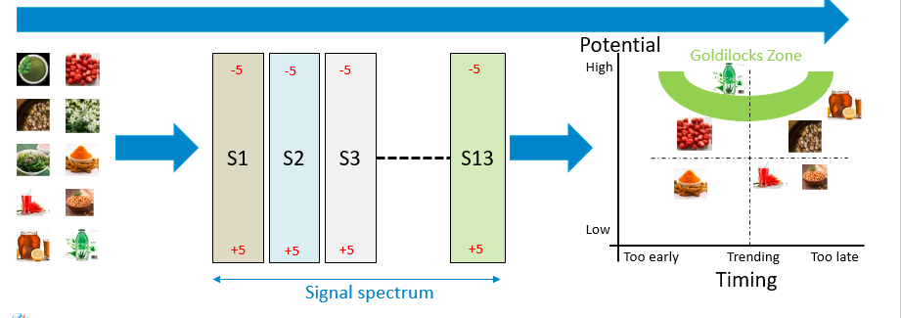
Mu Sigma helped a leading Food & Beverage manufacturer in enhancing the trend identification framework for Snack ingredients
Product Transponding (1/2)
Client offers a wide portfolio of snack and beverage products that are consumed by millions of people worldwide
The Food & Snacks division of the organization has a framework to identify the potential of any claim or ingredient through a manual process which executes large number of steps for any trend
Also, the framework only considers small number of data sources to arrive at the final estimation
The trend keywords are used as inputs and scored across 8 signals to generate an overall potential and timing score
The process evaluates input keyword against each signal where set of data sources are used to extract information about the trend
Based on the distribution of metrics, threshold ranges are calculated uniformly and a score is generated for the input trends
The trend scores from different signals are weighted and a consolidated score is generated to plot the trend on a potential vs time graph
The client wants to automate the existing framework for identifying the potential of a trend
Enhance the methodologies and include additional data sources to improve the results obtained
Utilize the capability developed to assist in innovation planning and launch strategies

Slide 6
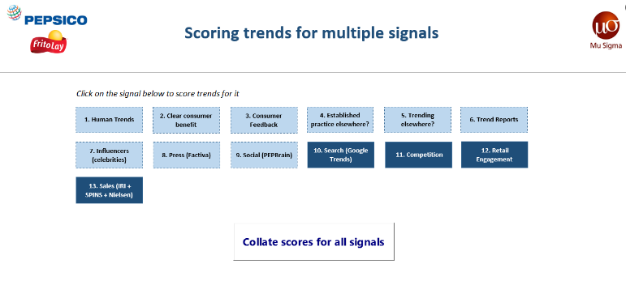
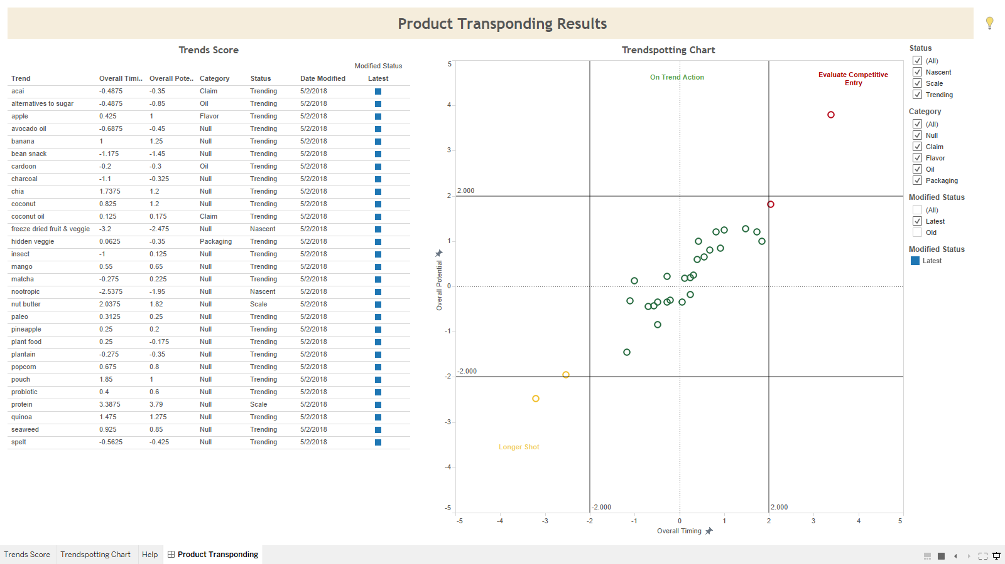
Based on the findings, the client will be able to take decisions to shape its innovation planning strategies
Product Transponding (2/2)
Certain signals influence the trend potential significantly as compared to others (e.g. sales, competition, social media)
Trends can be grouped across 4 main buckets based on their position on the graph, i.e. nascent, emerging, top performer or mature
The medium potential and medium timing area is referred as the goldilocks region from the reference of organization’s innovation strategy
An automated tool was developed for the consumption of business users
The tool takes input keywords that scores it across 8 signals and generates final scores
The methodology for each signal extracts information from multiple data sources globally
A front-end UI on Tableau represents the results in a graphical format
Based on the trends identified to be in the goldilocks region, the framework provides an opportunity to generate $40 MM through sales of each of the trend identified in that region
The tool automation has reduced the effort required to score a trend has 1 man-hour per trend approximately and now only takes 15 mins per trend (across all 8 signals)
The tool will be playing a pivotal role in innovation planning and product launches scheduled for the fiscal year

Slide 7
Agenda
Product Transponding
New Product Forecasting
Playbook Digitization
Share Forecasting

Slide 8
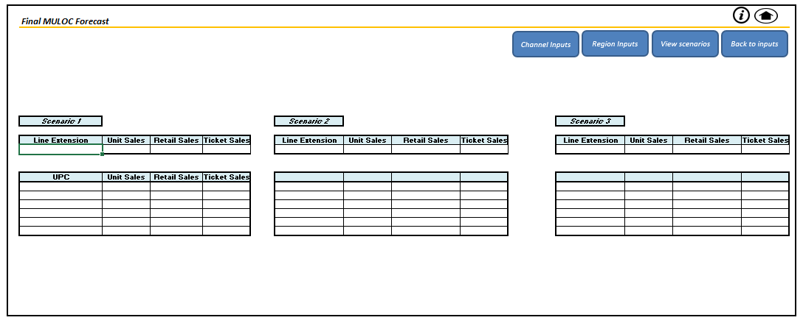
Mu Sigma helped a leading Food & Beverage manufacturer in enhancing the forecast accuracy for new product launches
New Product Forecasting (1/2)
Client offers a wide portfolio of snack and beverage products that are consumed by millions of people worldwide
The Insights team of the organization wanted to build an in-house capability to generate Year 1 forecasts for New Product launches
The tool takes into consideration Base Forecast inputs, Claims Recalibration inputs and Promotional Recalibration inputs
The variables under each category are as below:
Base Forecast: Product, Percent of Stores, Avg. Price/Unit, Launch Month, ACV, Type, Pack Size, Line Extension, Avg. Ticket Price/Unit, Item Launch Week
Claim Recalibrations: Claims
Promotion Recalibration: Line Extension, Purchase Intent, Advertising, Consumer Promotion, Trade Promotion
The process evaluates inputs on a scenario planner to evaluate prediction values for different values of the input
The algorithm uses a Random Forest model for the Base Forecast inputs and Linear Regression model for the Recalibration inputs
The client wants to automate the framework for the forecast model to forecast sales for any product
Utilize the capability developed to assist in launch strategies

Slide 9

Based on the findings, the client will be able to take decisions to shape its new product launch strategies
New Product Forecasting (2/2)
The forecast generated by the previous methodology was too high as compared to the actuals with a difference of 49%
The current forecast for 8 products is 1.85% different from the actuals hence resulting in a better accuracy
An automated tool was developed for the consumption of business users
The tool takes input for the base forecast and recalibration and generates forecast of sales
The methodology for each signal extracts information from multiple data sources – IRI and pre-launch inputs provided
A front-end UI represents the results in a tabular format
Based on the marketing spend per product, the average saving potential is estimated to be $5MM
The tool will be playing a pivotal role in understanding the sales associated with New Product launches scheduled for the fiscal year

Slide 10
Agenda
Product Transponding
New Product Forecasting
Playbook Digitization
Share Forecasting

Slide 11
Mu Sigma enabled a Food & Beverage manufacturer to plan better promotions for their products
Playbook Digitization (1/2)
Client offers a wide portfolio of snack and beverage products that are consumed by millions of people worldwide
The Marketing Division creates a National promotions calendar containing product promotion plans for the following year
Promotions calendar is created manually using several data sources and takes a man hours and manual effort every quarter
The project started with understanding and replicating the manual process of generating Promotions calendar
The data sources (product sales, category sales, major event-product associations, consumer segment-product category associations) are present in separate files in a mixture of formats
All data sources are first collated and aggregated into an excel file for the entire year, which is further used to create quarterly promotion calendars
The calendar creation methodology is based on business rules and is completely manual
Mu Sigma developed an interactive web-application which consumed all data sources and gave a recommended view of the promotions calendar, automating all the tasks involved in the process
The recommended calendar containing products and their promotion duration (in weeks) could be changed by the marketing team to incorporate strategic inputs on the web-app and later shared with a wider audience
Client wants to:
Reduce the time taken and manual effort to create the National Promotions Calendar
Have an interactive, scalable and standardized solution to create, edit and share the calendar with a wider audience

Slide 12
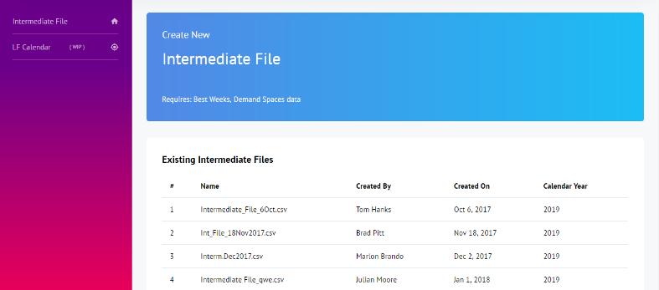
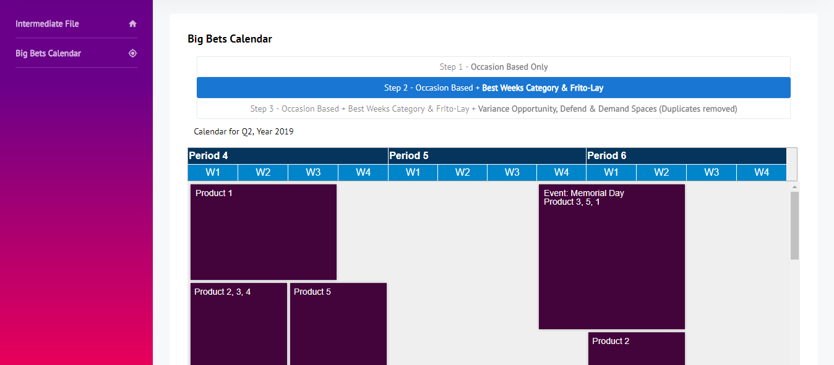
Based on the findings and solution the client will be able to plan product promotions in an efficient manner
Playbook Digitization (2/2)
The most significant data source to determine product placement and promotion duration on the calendar is sales – product sales and category sales
Overlapping promotions of the same products in the recommended calendar view are resolved by prioritizing category sales dataset
Playbook Digitization Web-App (1/2): Creating Intermediate File by uploading all data sources
Playbook Digitization Web-App (2/2): Recommended layout of the product promotions calendar
The web-app led to 94% reduction in time taken to create promotion calendars
Faster turnaround time and historical logs of promotion calendars will lead to more efficient promotions planning in the organization

Slide 13
Agenda
Product Transponding
New Product Forecasting
Playbook Digitization
Share Forecasting

Slide 14
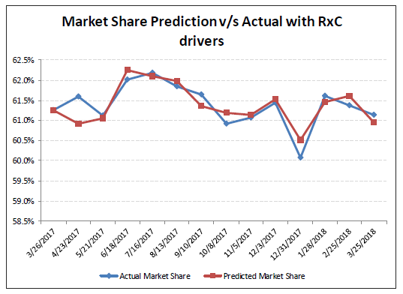
Mu Sigma is collaborating with a leading Food & Beverage manufacturer to accurately forecast market share at a MULO-C, Channel and Region level
Share Forecasting (1/2)
Client offers a wide portfolio of snack and beverage products that are consumed by millions of people worldwide
The Category management team wanted to be able to forecast market share for a year and control it through drivers affecting the same
The methodology employed to forecast market share gathers inputs from various Data sources:
IRI: Sales
Feature Vision: Promotions
OCR:E-commerce
Data Gov: Census data
For feature selection -Cross-correlation, Regression and Boruta techniques to extract drivers that influence the market share and ensured they are consumable by business while having good accuracy
Market share was further forecasted using multiple approaches such as ARIMA, ARIMAX, Random Forest, Prophet, ANN and selected the best ensemble approach
The team is currently in the process of building a scenario planner to let the business user generate various simulations of market share
The senior Finance and Category management leaders want to make informed decisions based on the share Forecasting model
The team wants to have visibility on various possible scenarios of market share through a driver based simulator

